Slide 1
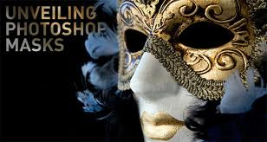
CS2033a/b Lecture 3 Image Manipulation II “The cool stuff” Vivi Tryphonopoulos

Slide 2
LECTURE #3 OVERVIEW
Topics:
What is a mask?
Why do we use masks?
Problems with other techniques and why masks are preferred
How do you create a mask?
Understanding: What you are doing when creating a mask!
Types of Masks
Layer Masks
Quick Mask

Slide 3
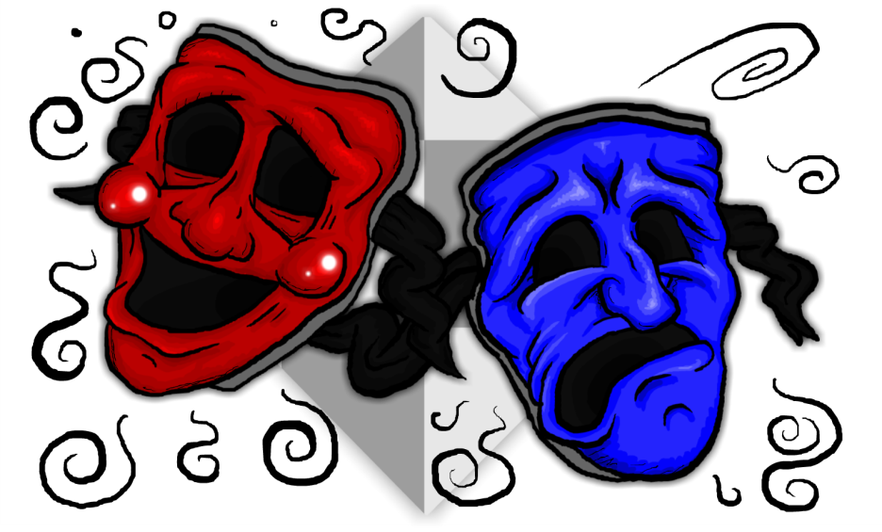
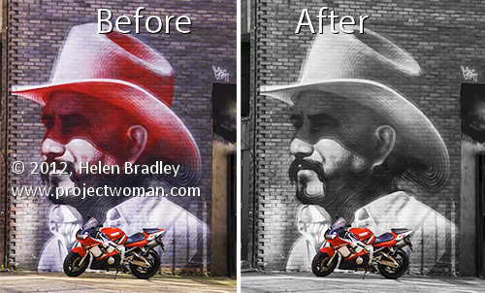
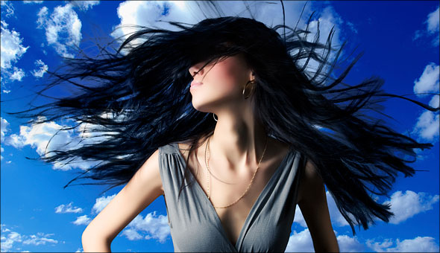
CHANNELS AND MASKING PANELS
Masks
Creating a Mask is one of the most accurate ways to make a selection and especially for tackling more difficult selections.
But First Need to look at:
What is a mask?
Understanding Masks and how they are used

Slide 4
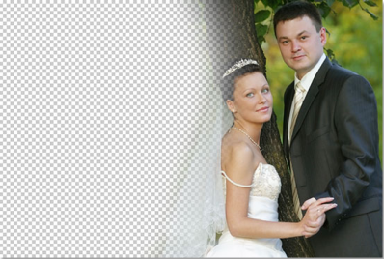
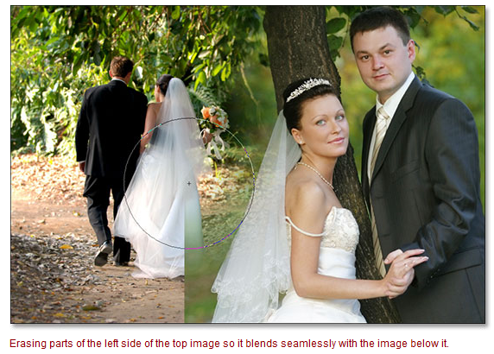
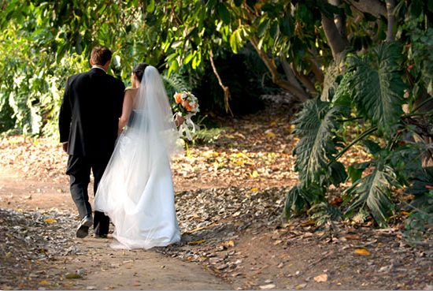
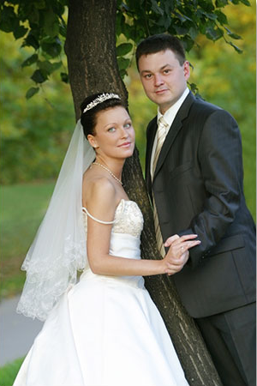
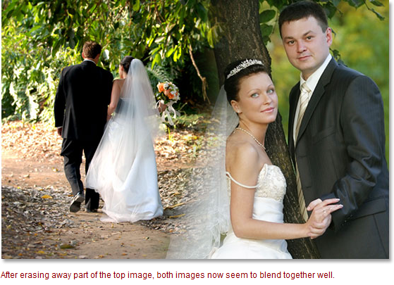
Case Scenario: Using Eraser Tool
Consider adding the couple to the background You have 2 layers
Try:
Use the Eraser tools with nice soft edges to erase the part of the image on the right that I don’t need.
Problem:
Too much of the veil was removed… Client wants it back
So this method doesn’t work!
So you have to start all over again.

Slide 5
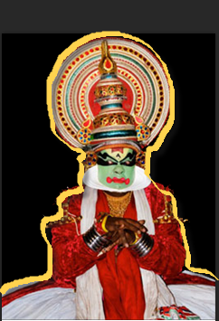
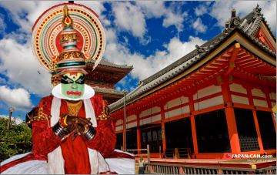
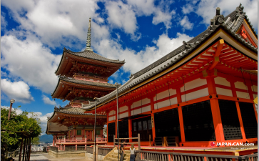
Case Scenario: Using Eraser Tool
Consider adding person to scenery You have 2 separate files
Method 1: (Select and Erase)
Selection tool to select the image.
Move it into the scenery background.
Eraser tool to erase pixels not needed.
Problems:
Accuracy is really hard to achieve
Once erased, its hard to get back

Slide 6
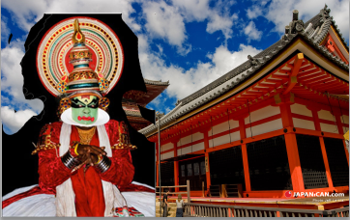
Method 2: (just Erase)
Move person into the scenery background file
Eraser tool to erase pixels not needed.
Eraser tool The amateurish tool?
Usually the first method Photoshop newcomers use to remove the background from an image
The Eraser tool allows you to erase areas on your image to either the background color or to transparency.
Solution:
Masks are the Photoshop Guru’s alternative to the Eraser tool.

Slide 7
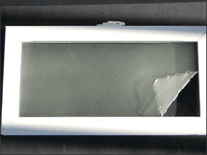
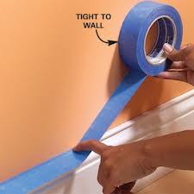
MASKS
When you think of masking?
Painting a Window
Use masking tape to tape up the glass pane so that you won’t paint on it.
Your are painting the trim only
Painting a Wall
Use masking tape to tape up baseboard
Your are painting the wall only
In Photoshop, Masking is the “digital equivalent”
Selected area: trim
Glass pane is masked.
Protected from being painted

Slide 8
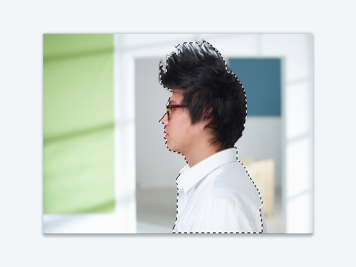
MASKS
Background is masked.
Protected from _______
What are Masks in Photoshop?
You have:
1 layer contains the image (background+person)
You want to work with only the face/body and not the background (coloring the shirt, hair)
How do you do it?
Use selection tool to select the part you want to change (YOU DO NOT NEED TO BE EXACT)
You create mask based on the selection
The selected portion of a mask can be altered
The area outside/around the selection is protected from change
The area you didn’t select is masked or thought of as being protected from editing.
Selected area: you __________
Selected area: trim
Glass pane is masked.
Protected from being painted

Slide 9
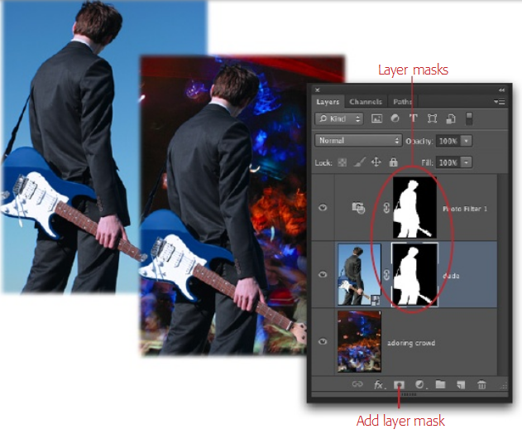
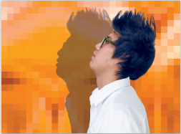
Background is masked.
Protected from change
MASKS
Why Use Masks?
Instead of deleting a background , you swap it with another one
Allows you to manipulate specific parts of an image ie. color hair, shirt, tilt head

Slide 10
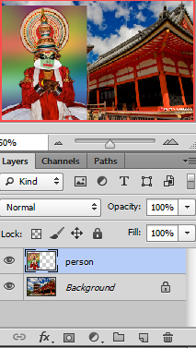
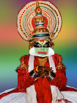
MASKS
So how does one work with Masks?
Step 1: (2 layers evident)
You have your background scene.
You have your person.
Make sure you are on the layer of the model.
Decide to make a selection or not... Press on “Add Layer Mask” icon

Slide 11
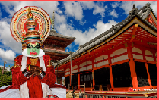
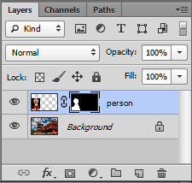
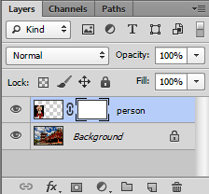
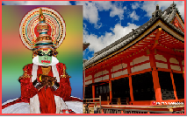
MASKS
Step 2 : Select or not Select?
If Select
Use selection tool to select outline of person
Add a Layer Mask to the layer
Layer mask is filled with black and white.
If don’t Select
Add a Layer Mask to the layer
Layer mask is filled with white
Why is one mask filled
with b/w and the other white?

Slide 12
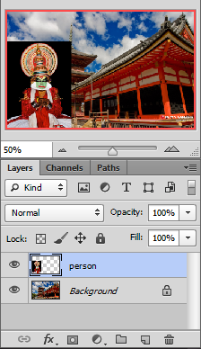
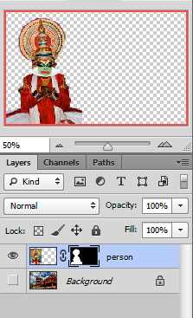
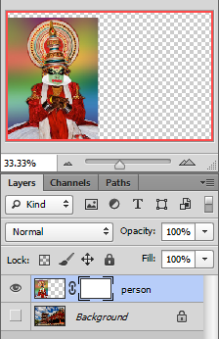
MASKS
Why is one mask filled
with b/w and the other white?
Remember: “Black conceals white reveals”
A black mask hides everything
on that layer.
A white mask
reveals everything on that layer
= visible
Selection was done
No Selection was done

Slide 13

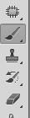
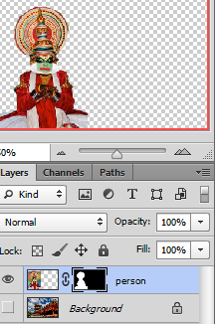
MASKS
Step 3: Brush tool to paint pixels
Concept: Brush with : (foreground color) Black to remove areas you want to hide
White to bring back areas you want visible
Grey – controls opacity
In this case, we have a black mask:
We had selected too much prior to masking layer
Thus: we need to bring back some pixels (make it visible)
Brush with White
Use Foreground color → White
Get your Brush Tool
Set the diameter and a soft edges
Click on your mask in the layer palette
And now start painting over the pieces you want to appear (because you are painting with white)
Black mask conceals
- Paint with white to make pixels visible
IF you ADDED TOO MUCH Swap to black AND brush → hide areas (conceals)

Slide 14
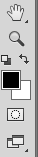
MASKS
Concept: Brush with : Black to remove areas you want to hide
White to bring back areas you want visible
Grey – controls opacity
In this case, we have a white mask:
We have too much of the image revealed... We want to hide the pixels around the person
White mask reveals
- Paint with black to reveal pixels
Brush with Black
Use Foreground color → black
Get your Brush Tool
Set the diameter and a soft edges
Click on your mask in the layer palette
And now start painting over the pieces you want to hide (since you are painting with black)
IF you REMOVED TOO MUCH Swap to WHITE AND brush → bring back areas to be white

Slide 15
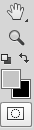
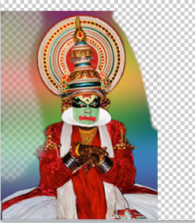

MASKS
Concept: Brush with : Black to remove areas you want to hide
White to bring back areas you want visible
Grey – controls opacity
What if we brush with Gray color
It doesn’t matter whether you are on a white or black mask.
Gray will reduce pixel opacity → trying to hide pixels: partially hide them → trying to make pixels visible (or appear), it will partially make them appear
Brushed with black
Brushed with grey

Slide 16
MASKS
I hope you are all asking yourself
So what’s the difference between using Eraser and a Mask?
ADVANTAGE of MASKS:
Pixels are NOT removed permanently
They are hidden or made visible
You can remove/add effortlessly →swapping between black/white until you get it right
Work during different Photoshop sessions (still have accessibility to those pixels)
Power of masks:
You “mask” pixels, don’t eliminate them!
If you mask pixels, you can them at any time during the same session or another session.
ERASER :
Once pixels are removed →Permanently removed!
If you eliminate them you lose them – can’t bring them back
Limited with Undo/step backwards
HISTORY STATE:
Can go back to a state but what if you closed the file and want to work on file another day?
http://wegraphics.net/blog/tutorials/photoshop/photoshop-for-beginners-understanding-layer-mask/

Slide 17
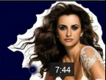
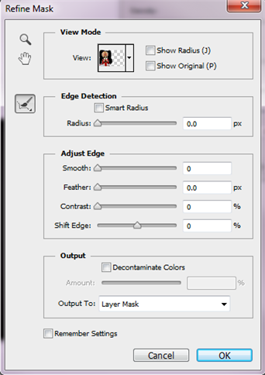
MASKS
PROBLEM with Masks:
Still need accuracy on edges
Solution is Refine Mask (will learn in lab)
Let’s look at this tutorial
http://www.youtube.com/watch?v=ZCvZwwIq8gU(8min )
Smart Radius: Automates the selection for us to refine those edges
Paint around the edges: Look in those areas for a better selection (great for fine details such as hair)
Smooth: Smooth out the jagged edges
Contrast: making the edge _____ (stronger)
Shift Edge: pulling in or pulling out
Decontaminate Colors: Helps the edges _______more with what is surrounding it

Slide 18
MASKS
Why Use Masks?
Instead of deleting a background , you swap it with another one
Allows you to manipulate specific parts of an image( blur a part of the image, adjust hue, saturation, puppet warp etc.)

Slide 19
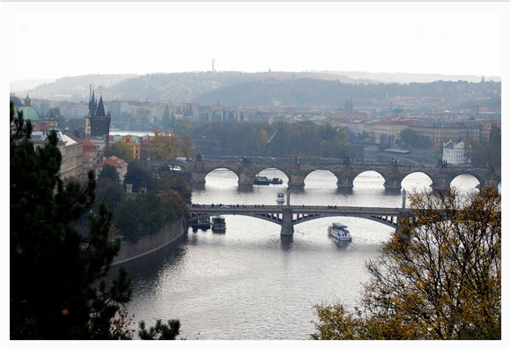
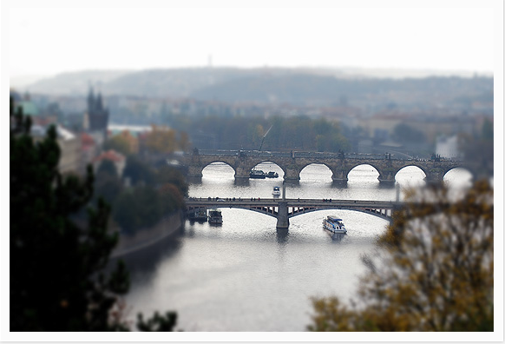
MASKS
Why Use Masks?
Tilt_Shift Photography
Placing the focus on a subject in the foreground while blurring out the background & vice versa.
When choosing a photograph for the tilt-shift effect, bear in mind that you want to give the impression of a miniature model. TIP: Miniature models are usually viewed from above so try and choose a photo with an elevated viewpoint. Buildings, roads, traffic and railways are excellent choices but make sure there is a reasonable wide angle of view.
Some awesome efffects with masks and ideas:
http://wegraphics.net/blog/tutorials/photoshop/photoshop-for-beginners-understanding-layer-mask/

Slide 20
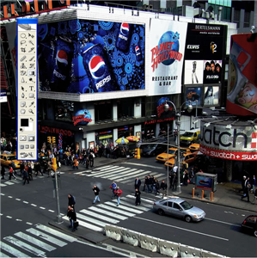
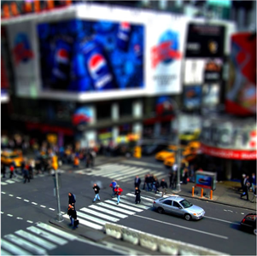
MASKS
Why Use Masks?
Tilt-Shift Photography (Times Square, New York)
http://www.tiltshiftphotography.net/tilt-shift-photography-photoshop-tutorial/#.UPuWI2d36M0

Slide 21
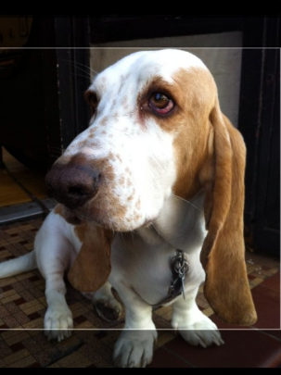
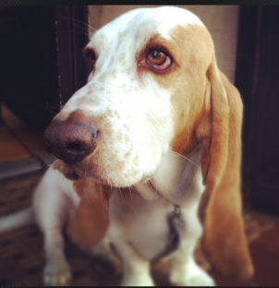
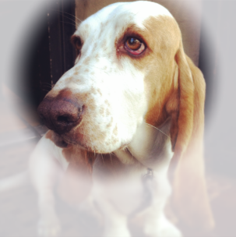
Why Use Masks?
Tilt-Shift Photography ( Subject becomes focus, and everything around is blurry)

Slide 22
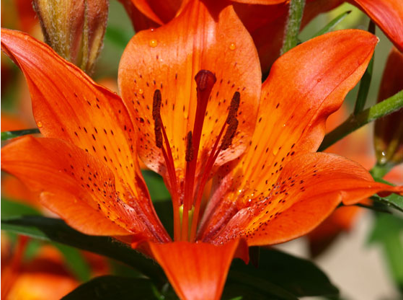
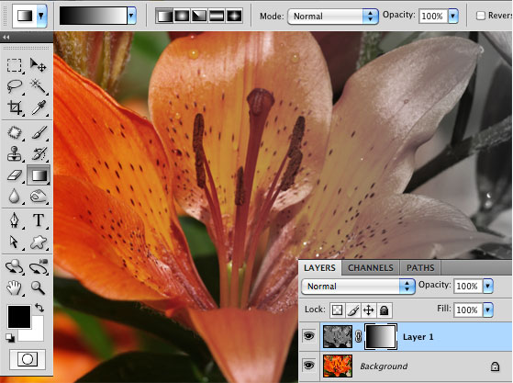
Why Use Masks?
Use Gradient Tool: To go from color to gently black and white
Some awesome efffects with masks and ideas:
http://wegraphics.net/blog/tutorials/photoshop/photoshop-for-beginners-understanding-layer-mask/

Slide 23
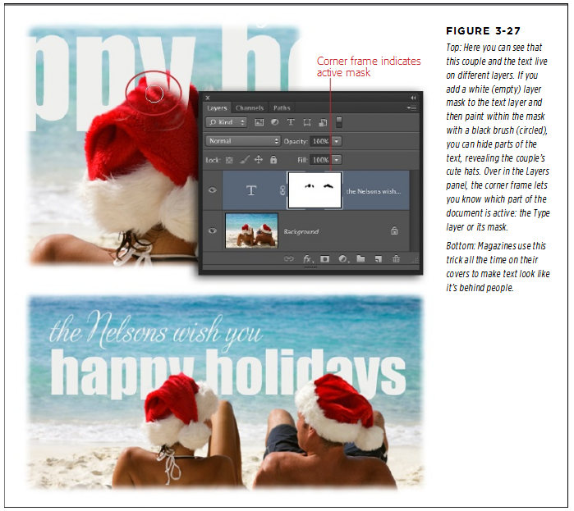
Why Use Masks?
Hide text to make it appear that it is behind something
Extracted from http://www.scribd.com/doc/92203172/Photoshop-CS6-The-Missing-Manual go to pg 143

Slide 24
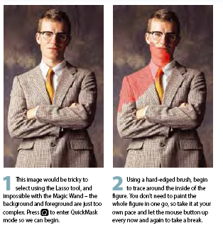
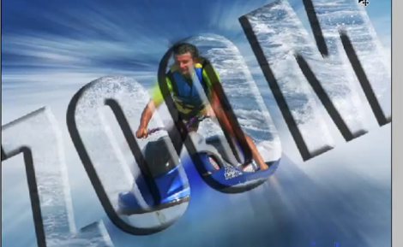
Mask Types we have explored
Clip Mask from Text
Layer Masks
Quick Masks
In these cases we are making selections → Alternative to basic selection tools ie. Marquee, lasso etc.
Why? Pixels are NOT removed permanently
Quick Mask selections → Alternative to basic selection tools ie. Marquee, lasso etc.
Why? Provides better accuracy – you are painting on top of the areas you want to select or excluder from selection
It is ________________unless you save it unless you save selection on a new layer

Slide 25
Quick Mask – allows you to make a selection
Great article.. Read it!
You are NOT creating a mask you are entering a MODE
Quick Mask is a way to make a selection with the Paint Brush
Similar to selection tools like Marquee, Lasso, etc...
But you are painting in an area to become your selection
How to create a Quick Mask
Enter Quick Mask Mode
Use your brush to paint over the selection you want (person) - uses red overlay
As you paint it is red...
Then exit Quick Mask(press Q)
The marching ants appear

Slide 26
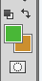
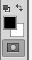
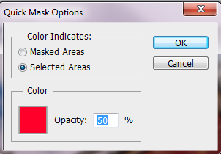
Quick Mask – allows you to make a selection
The moment you click on Quick Mask Mode
Defaults when in Quick Mode
Foreground – Black (paints)
Background – White (unpaints)
Color overlay – Red (and transparent)
Color Indicates: Masked Areas You are saying what you don’t want as part of your selection → Backwards
TIP:
Thus check “Selected Areas”
What you paint is the actual selection (what you will be adjusting ie. Hue, saturation, etc.)
Opacity setting: leave as 50% so that you can see what is below in when you are painting

Slide 27
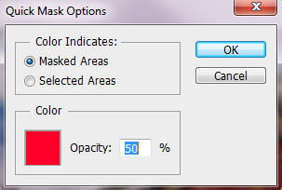

Quick Mask – allows you to make a selection
You are painting the non-masked selection areas:
Thus the man is really what you will be adjusting later. Ie. Color of bg, saturation etc.
You are painting the masked areas:
Thus the background is really what you will be adjusting later. ie. Color of bg, saturation etc.

Slide 28
Quick Mask – allows you to make a selection
Make errors in painting?
Swap colors Set foreground
Black → painting red →adding to selection
White →unpainting → removing from selection

Slide 29



Quick Mask – allows you to make a selection
Exited Quick Mask Mode
In Quick Mask Mode
Very Important!!
No mask layer is made
Ready for you to do something with the selection

Slide 30







Quick Mask What can I do with the selection?
Once marching ants.. Can color, gradient, etc... Anything you want !!
There is no mask layer!
Once marching ants.. Inverse so bg is selected and can be colored etc.
There is no mask layer!
Once marching ants.. Extract selection and put it on a layer of its own
There is no mask layer!

Slide 31
Quick Masks
Summary:
The advantage to using Quick Mask Mode rather than one of the standard selection tools is that you can have more accuracy control (right down to the pixel).. Because you are painting the pixels
These are temporary masks which are used once. (exactly like another Selection tool). You use Quick Mask to make a selection and then apply some operation to the selection. Once you turn off the selection, Quick Mask is finished.
Although you do not have a mask layer created from it. BUT Layer Masks can be copied to other layers. They can be temporarily disabled and then re-enabled at any point
Layer Masks are non-destructive and can be reversed, reduced or modified at any subsequent point..
It is used once

Slide 32
Your HOMEWORK
Go through the notes trying things out
BEFORE THE Lab...
It will help you understand
What you are doing!
Learn the techniques
Practice makes perfect
and easier to work with the tools

